Slide 1

Network+ Guide to Networks 6th Edition
Chapter 15
Network Management

Slide 2
Objectives
Explain basic concepts related to network management
Discuss the importance of documentation, baseline measurements, policies, and regulations in assessing and maintaining a network’s health
Manage a network’s performance using SNMP-based network management software, system and event logs, and traffic-shaping techniques

Slide 3
Objectives (cont’d.)
Identify the reasons for and elements of an asset management system
Plan and follow regular hardware and software maintenance routines

Slide 4
Fundamentals of Network Management
Network management
Assess, monitor, and maintain all network aspects
Scope differs according to network’s size and importance
Several network management disciplines
All share same goals
Enhance efficiency and performance
Prevent costly downtime and loss
Predict problems before they occur

Slide 5
Documentation
Network aspects to document
Physical topology
Access method
Protocols
Devices
Operating systems
Applications
Configurations

Slide 6
Documentation (cont’d.)
Configuration management
Collection, storage, assessment of configuration documentation
Documenting all network aspects
Saves future work
Network diagrams
Graphical representations of network’s devices, connections
Use popular Cisco icons
Provide broad snapshot of network’s physical or logical topology

Slide 7
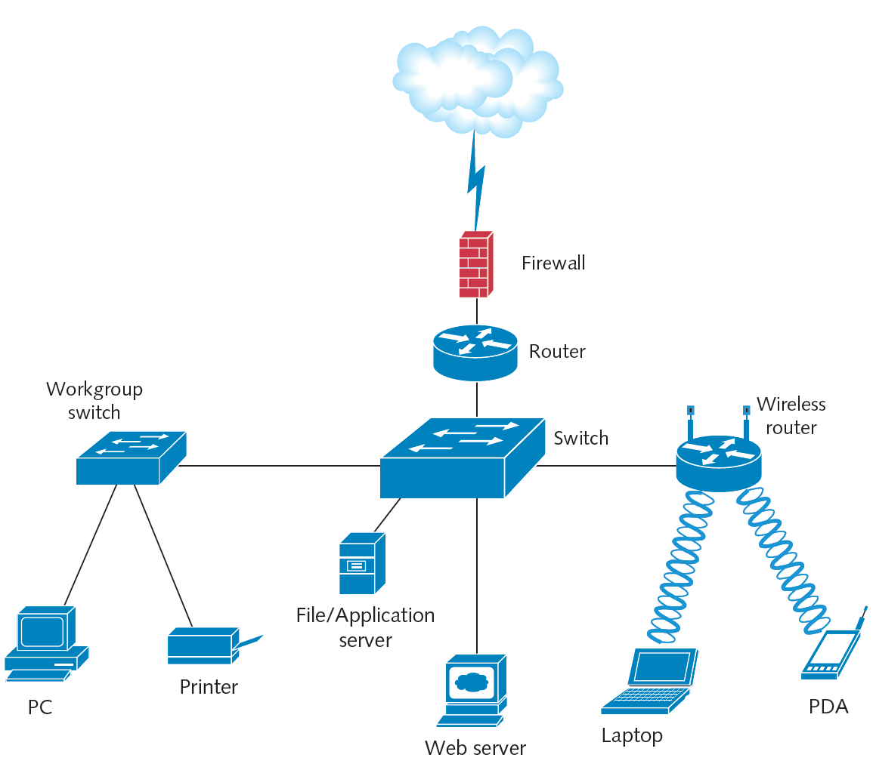
Figure 15-1 Network diagram using Cisco symbols
Courtesy Course Technology/Cengage Learning

Slide 8
Documentation (cont’d.)
Wiring schematic
Graphical representation of network’s wired infrastructure
Detailed form
Includes every wire connecting network devices
Less detailed form
Single line represents group of wires connecting several clients to a switch

Slide 9
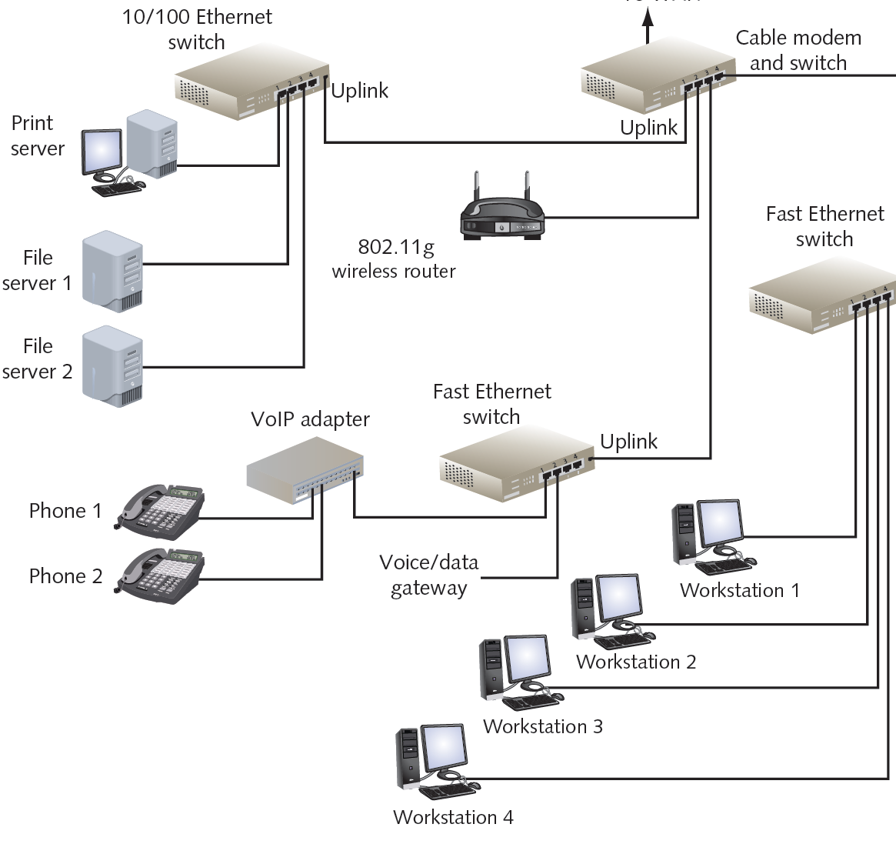
Figure 15-2 Wiring schematic
Courtesy Course Technology/Cengage Learning

Slide 10
Baseline Measurements
Baseline
Report of network’s current operation state
Example baseline measurements
Network backbone utilization rate
Number of users logged on per day or per hour
Number of protocols running on network
Error statistics
Runts, collisions, jabbers, giants
Frequency of application use
Bandwidth usage

Slide 11
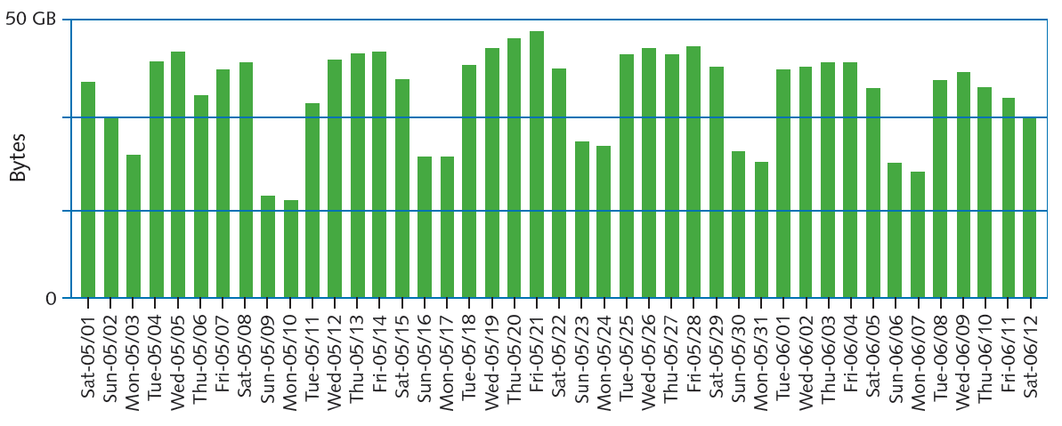
Figure 15-3 Baseline of daily network traffic
Courtesy Course Technology/Cengage Learning

Slide 12
Baseline Measurements (cont’d.)
Compare future and past performance
Most critical network, user functions
More data provides more accuracy
Forecasting network traffic patterns
Difficult to predict users’ habits, new technology effects, changes in resource demand
Gathering baseline data
Software applications
Freeware
Expensive, customizable hardware and software
Determine use before selecting

Slide 13
Policies, Procedures, and Regulations
Rules limit chaos, confusion, downtime
Sound network management policies
Media installation and management
Network addressing policies
Security-related policies
Troubleshooting procedures
Backup and disaster recovery procedures

Slide 14
Policies, Procedures, and Regulations (cont’d.)
State and federal regulations
CALEA (Communications Assistance for Law Enforcement Act)
Telecommunications carriers, equipment manufacturers must provide for surveillance capabilities
HIPAA (Health Insurance Portability and Accountability Act)
Protect medical records security and privacy
Many policies and procedures
Not laws
Best practices to prevent network problems

Slide 15
Fault and Performance Management
Assess network’s status on an ongoing basis
Performance management
Monitor links and devices’ ability to keep up with demand
Fault management
Detection and signaling of device, link, component faults

Slide 16
Network Management Systems
Enterprise-wide network management systems
Accomplish fault and performance management
All use similar architecture
Polling
Collecting data from multiple networked devices at regular intervals
Agent
Software routine
Collects information about device’s operation
Provides information to network management application

Slide 17
Network Management Software (cont’d.)
Various aspects of a device can be managed
Processor, memory, hard disk, NIC, and intangibles
MIB (Management Information Base)
Contains managed devices definition, data
SNMP (Simple Network Management Protocol)
Used to communicate managed device information
Part of TCP/IP suite
SNMPv3: most secure version of the protocol
SNMPv2 still widely used

Slide 18
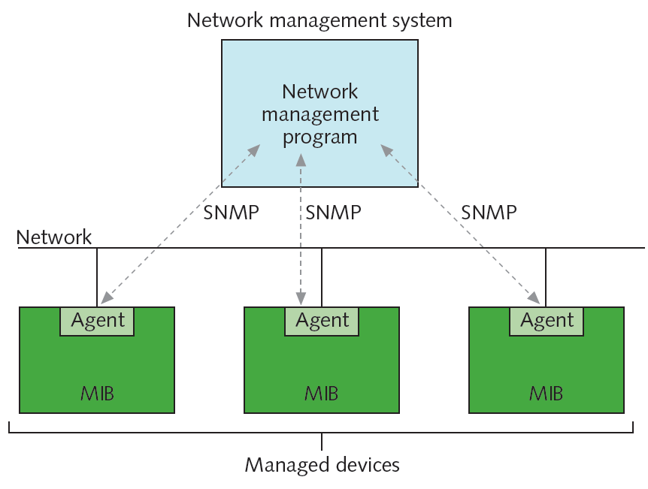
Figure 15-4 Network management architecture
Courtesy Course Technology/Cengage Learning

Slide 19
Network Management Software (cont’d.)
Several ways to view and analyze data
Network management applications
Flexible
Challenging to configure and fine-tune
Choose correct type and amount of information to collect
Faults can trigger alarms
Also recorded in system and event logs

Slide 20
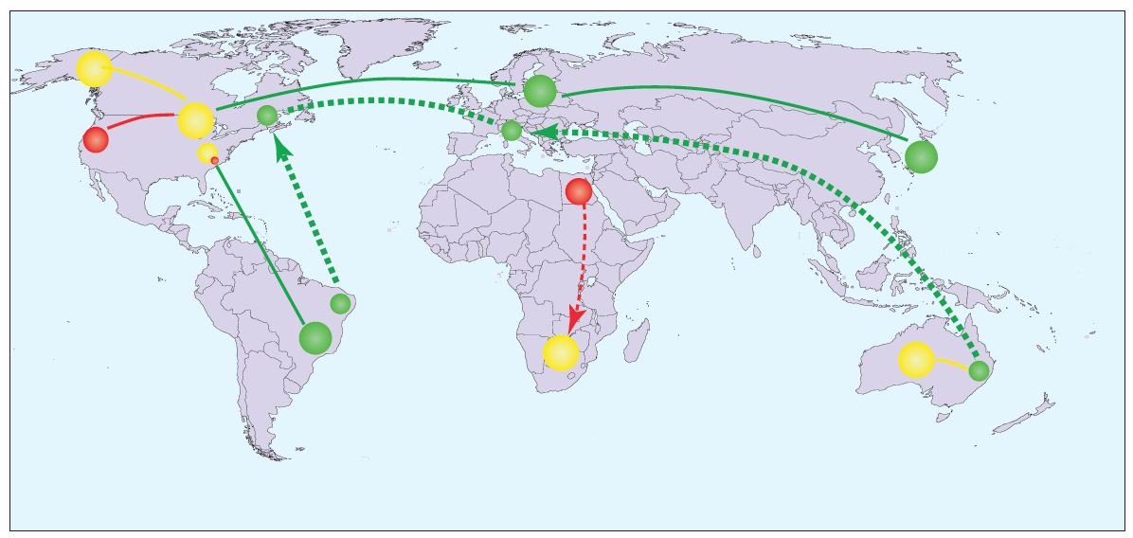
Figure 15-5 Map showing network status
Courtesy Course Technology/Cengage Learning

Slide 21
System and Event Logs
Log
Contains recorded conditions recognized by operating system
Event log
Windows-based computer log containing monitored device information
Event Viewer application
Application to view log information in Windows

Slide 22
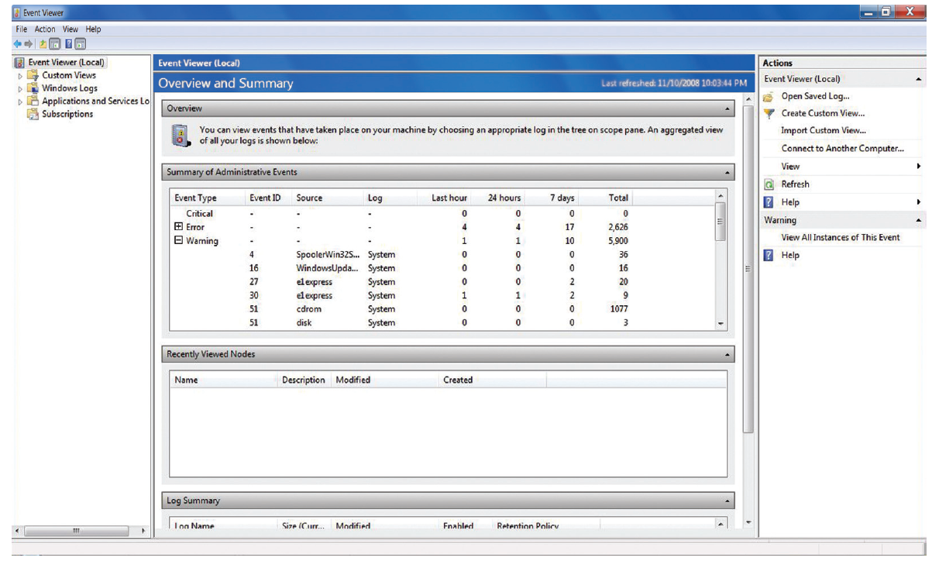
Figure 15-6 Event log on a workstation running Windows 7
Courtesy Course Technology/Cengage Learning

Slide 23
System and Event Logs (cont’d.)
Syslog function
Standard for generating, storing, and processing messages about events on Linux or UNIX
Data written to system log
Using logs for fault management
Logs keep history
Information collected does not point to problem
Logs must be monitored for errors
Application used for viewing, filtering information

Slide 24
Traffic Shaping
Traffic shaping
Manipulating packet, data stream, and connection characteristics
Manage type and amount of traffic traversing network
Goals
Assure timely delivery of most important traffic
Offer best possible performance for all users

Slide 25
Traffic Shaping (cont’d.)
Techniques
Delay less important traffic
Increase priority of more important traffic
Traffic policing
Limit traffic volume flowing in and out of interface during specified time period
Limit momentary throughput rate for an interface
Not without controversy
Comcast discriminated against certain traffic types

Slide 26
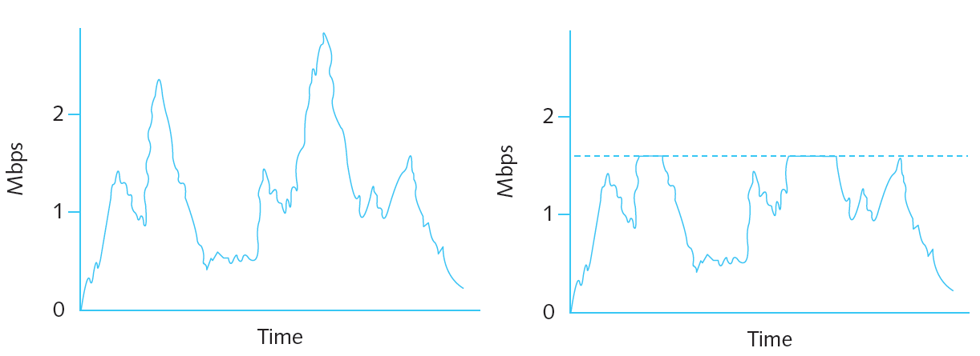
Figure 15-7 Traffic volume before and after applying limits
Courtesy Course Technology/Cengage Learning

Slide 27
Traffic Shaping (cont’d.)
Traffic prioritization
Treating more important traffic preferentially
Prioritization based on characteristics
Protocol
IP address
User group
DiffServ (Differentiated Services) flag or TOS (type of service) field in IP datagram
VLAN tag in Data Link layer frame
Service or application

Slide 28
Caching
Caching
Local storage of frequently needed files
Allows quick access
Web caching
Most common caching type, highly customizable
Web pages stored locally
On host or network, and then delivered to requesters
ISP cache engine
Network device devoted to storage, frequently requested file delivery
Saves money; lowers WAN traffic

Slide 29
Asset Management
Identifying and tracking hardware and software
First step
Inventory each network node
Organization needs
Determine appropriate asset management tool
Benefits
Simplifies maintaining and upgrading network
Provides information about hardware and software costs and benefits

Slide 30
Change Management
Managing change while maintaining network efficiency and availability:
Requires good planning
Common software and hardware changes
Range from installing patches to replacing network backbone
Several ways to approach changes

Slide 31
Software Changes
Software upgrades
Important for keeping system running optimally
Application patches and upgrades
Correction, improvements, and enhancements to particular software application
Change only part of an application
General steps
Determine whether patch or upgrade is necessary
Research change purpose, compatibility, and effects
Determine whether changes should apply to all users
Determine distribution method

Slide 32
Software Changes (cont’d.)
General steps (cont’d.)
Notify appropriate personnel of intent to change
Back up current system
Prevent users from accessing system during change
Keep instructions handy as you install revision
Implement the change
Test system fully
Re-enable access to the system
Or revert to previous version
Inform personnel that change is complete
Record change in the change management system

Slide 33
Software Changes (cont’d.)
NOS (Network Operating System) upgrades
Most critical upgrade type
Involves significant and potentially drastic changes to the way servers and clients operate
Upgrade requires forethought, product research, and rigorous testing
Ask and answer significant questions
Create a project plan
Complex, far-reaching change
Ensure appropriate budget, resources, and time

Slide 34
Software Changes (cont’d.)
Steps in NOS upgrade
Research
Project plan
Proposal
Evaluation
Testing
Training
Preimplementation
Implementation
Postimplementation

Slide 35
Software Changes (cont’d.)
Reversing a software upgrade
Software change may create unexpected problems
Be prepared to reverse an upgrade
Backleveling
Reverting to previous version of software after attempting upgrade
No hard-and-fast rules for backleveling
Always refer to software vendor’s documentation to reverse an upgrade
For NOS: consult other professionals as well

Slide 36
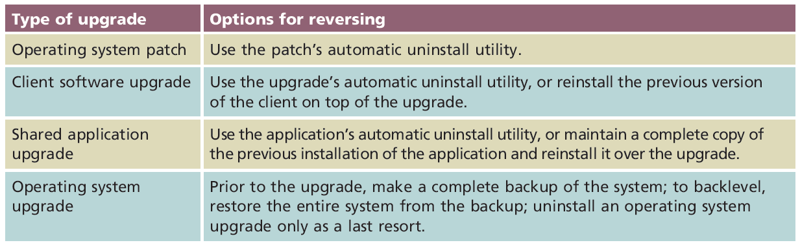
Table 15-1 Reversing a software upgrade
Courtesy Course Technology/Cengage Learning

Slide 37
Hardware and Physical Plant Changes
Required when network component fails or malfunctions
More commonly performed as upgrade
Increase capacity, improve performance, and add network functionality
Face same issues as software changes
Proper planning is key
Follow steps on Pages 712-713 of text

Slide 38
Hardware and Physical Plant Changes (cont’d.)
Adding or upgrading equipment
Difficulty determined by past use; experience with hardware or vendor
Take time to research, evaluate, and test unfamiliar equipment
Rapid hardware industry changes
May affect consistency of installed products
If consistency is a concern
Purchase as much hardware as possible in single order
Purchase from same vendor

Slide 39
Hardware and Physical Plant Changes (cont’d.)
Adding or upgrading equipment (cont’d.)
Different preparation and implementation requirements for each device type
Read manufacturer’s instructions
Gain experience with networking equipment
Follow general guidelines for each device type
Devices that are most disruptive and complex to add or upgrade
Most difficult to remove or backlevel
Keep safety in mind when upgrading and installing network hardware

Slide 40
Hardware and Physical Plant Changes (cont’d.)
Cabling upgrades
Can require significant implementation planning
Depending on network size
Troubleshooting cabling problems
Easier with current and accurate wiring schematics
Carefully document existing cable before making upgrades
Ensures future upgrades go smoothly
Consider upgrading in phases

Slide 41
Hardware and Physical Plant Changes (cont’d.)
Cabling upgrades (cont’d.)
Weigh upgrade importance against disruption potential
Organizations with very small networks
Upgrade own network cabling
Larger organizations
Rely on contractors

Slide 42
Hardware and Physical Plant Changes (cont’d.)
Backbone upgrades
Most comprehensive and complex upgrade
Backbone represents main data conduit
Requirements
Extensive planning, personnel efforts, and investment
Upgrading entire backbone changes the whole network

Slide 43
Hardware and Physical Plant Changes (cont’d.)
Reversing hardware changes
Provide way to reverse hardware upgrade
Reinstall old hardware
Faulty component: reinstall not possible
Keep old components safe and nearby
May need to reinstall
Refer to it for information

Slide 44
Summary
Network management
Assessing, monitoring, and maintaining network devices and connections
Configuration management
Software and hardware configuration documentation
Network management applications use SNMP to communicate with managed devices
System logs and event logs record conditions
Software and hardware upgrades require planning

